Slide 1
DesignVillage
BY RUMI

Slide 2
What Is Design To Me ? To work with someone it is essential to be know the person better first
-Rumi-
“Rumi Ahuja is all about pure design made with uncompromised craftsmanship”
“The whole difference between construction and creation is this; that a thing constructed can only be loved after it is constructed but a thing created is loved even before it is created.”
Rumi”s journey in the fascinating world of couture has a humble beginning from the by lanes of delhi . where he grew up in the childhood steeped in art , culture and music. The years of intense hard work cumulated when he graduated in interior designing and decided to start up @home to start a carrer in interior fashion as a stylist , he has come a long way since then to be recognized as one of the leading designers in delhi ,
To me a great space is your daily needs draped in a way that they act like a beautiful crafted piece of accessory ,

Slide 3
Asquare Designs Designing Spaces
ASQUARE DESIGNS DESIGNING SPACES
We are located where our client need us , “asquaredesigns” stands for Aesthetics and Ambiance”
The company provides interior design and consultancy services with turnkey installations for varied types of projects including corporate & housing sectors.
Our design studio develops interior where comfort scale and discreet ornamentation come together in a beautiful and meaningful spaces for the people who inhabit them .

Slide 4
dESIGN VILLAGE BY RUMI
DESIGN VILLAGE
DesignVillage is a unique store which offers various different kind of products that are needed to construct a beautiful home ,
We do manufacture & import state of the art home furnishings , bed spreads quilts table dressings cushion cover etc . we serve quality cutlery and dinner ware , for you to enjoy food in the best possible way ,
Above from home dressings we offer & design customize lighting , finest wooden floorings , sanitary ware , wallpapers , curtains & blinds and other accessories which give any ordinary space a desirable look ,
We are not just limited to above our store offers a café for non-veg lovers which serves one of the kind home cooked chicken and mutton served with bread or rice and a plant nursery which serves great collection of potted plants to be kept inside out , our store also offers designer apparels handcrafted by the ladies of Rajasthan

Slide 5
SERVICES WE OFFER
-SPACE PLANNING
-STYLING
-SELECTION PROCESS
-FALSE CEILING
-HVAC JOBS (ALL KIND – WINDOW – SPLIT – CASSETTE – TOWER)
-ELECTRICALS
-MODULAR FURNITURE
-(CIVIL WORK ON TURNKEY BASIS)

Slide 6
PRODUCTS WE OFFER
-WOODEN FLOORING
-WALLPAPER
-PVC PANLES
-PVC FLOORING
-ARTIFICIAL GRASS
-VERTICAL GARDENS
-ALL KIND OF BLINDS
-UPHOLSTERY FABRICS BY D-DÉCOR & REST

Slide 7
-WE UNDERTAKE PROJECTS WITH TIME COMMITMENTS & CORE RESPONSIBILTY
-WE ASSURE THE BEST QULAITY RELIABLE PRODUCTS WITH VALUABLE GUARANTEES

Slide 8


Slide 9
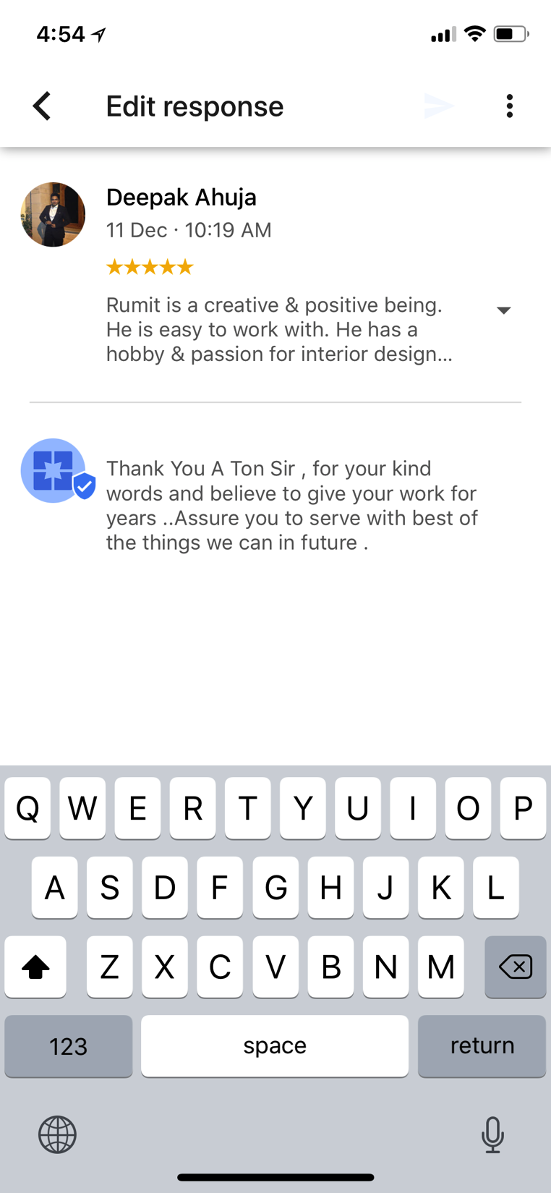

TESTIMONIALS

Slide 10
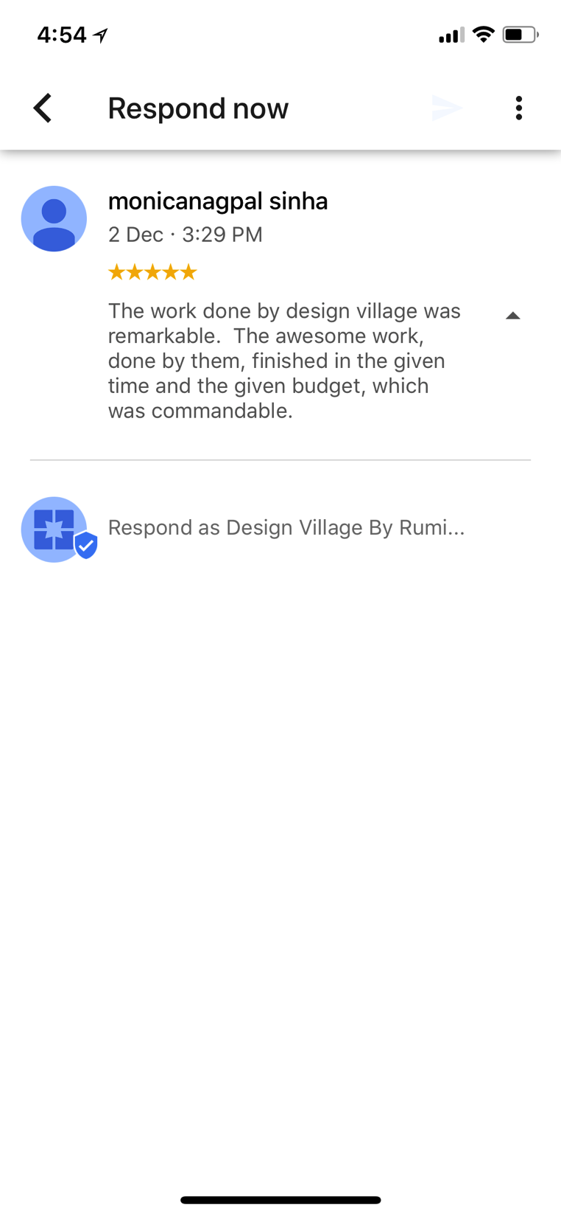
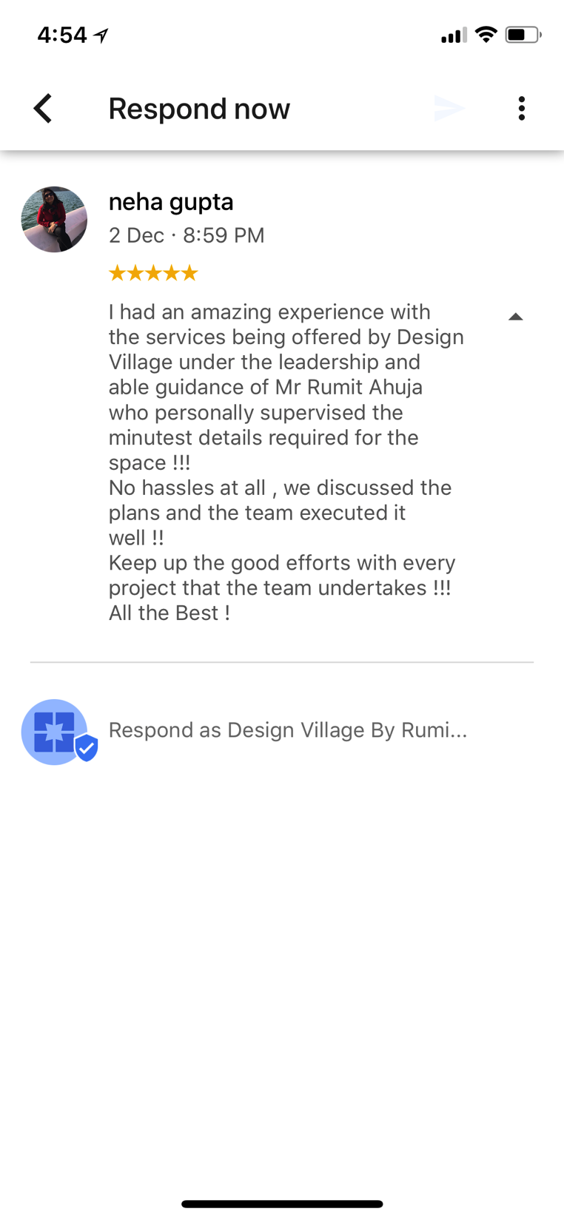
Thank You For Your Forever Trust
Thank You For Your Forever Trust

Slide 11
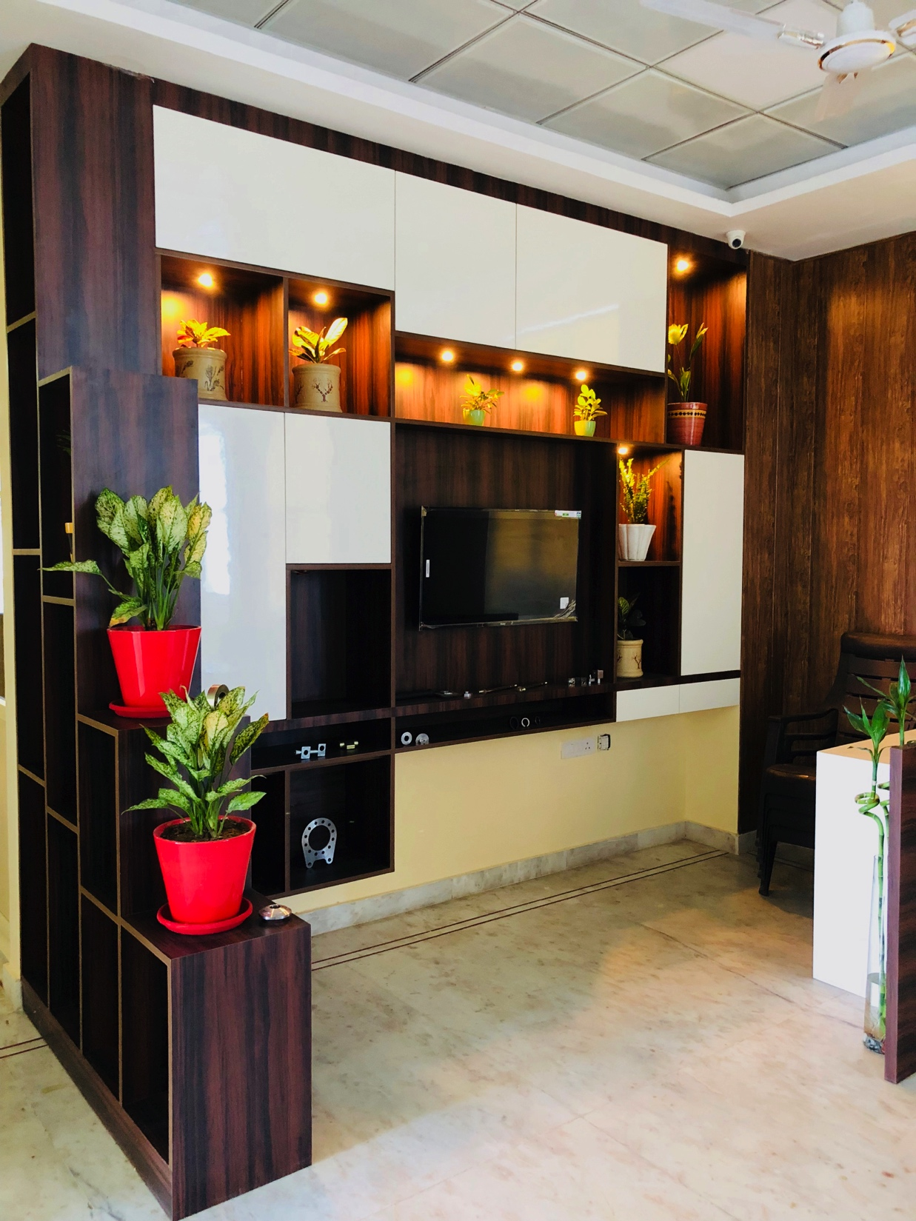
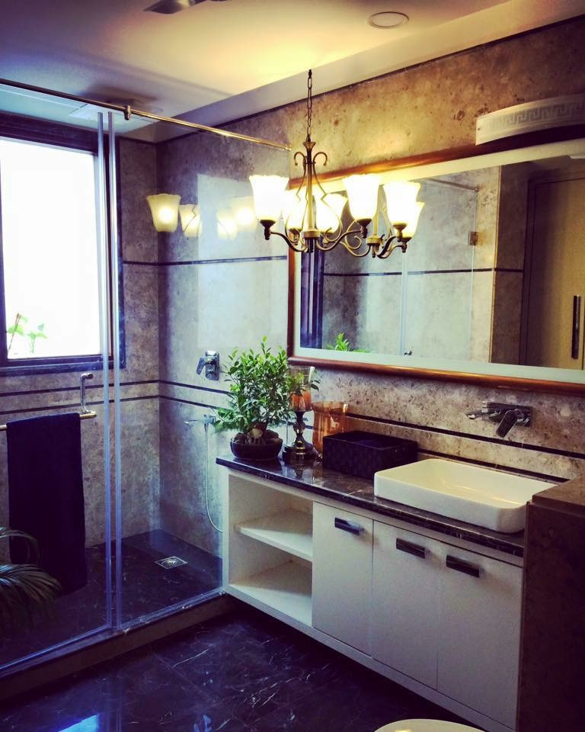
Our Finished Spaces

Slide 12
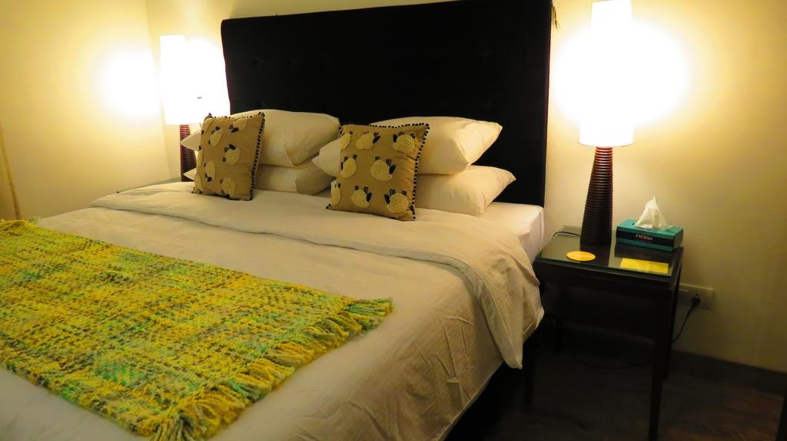
Our Finished Spaces

Slide 13
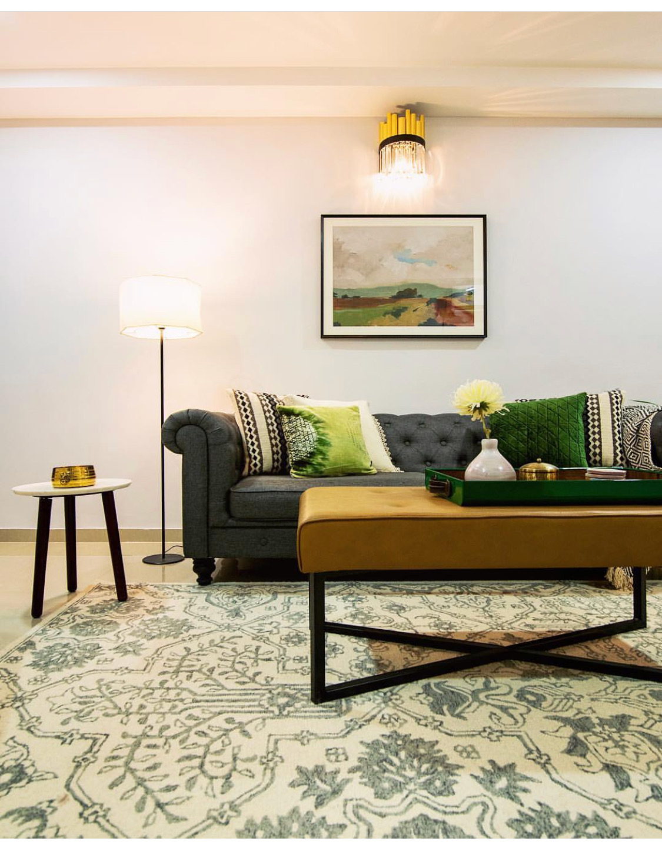
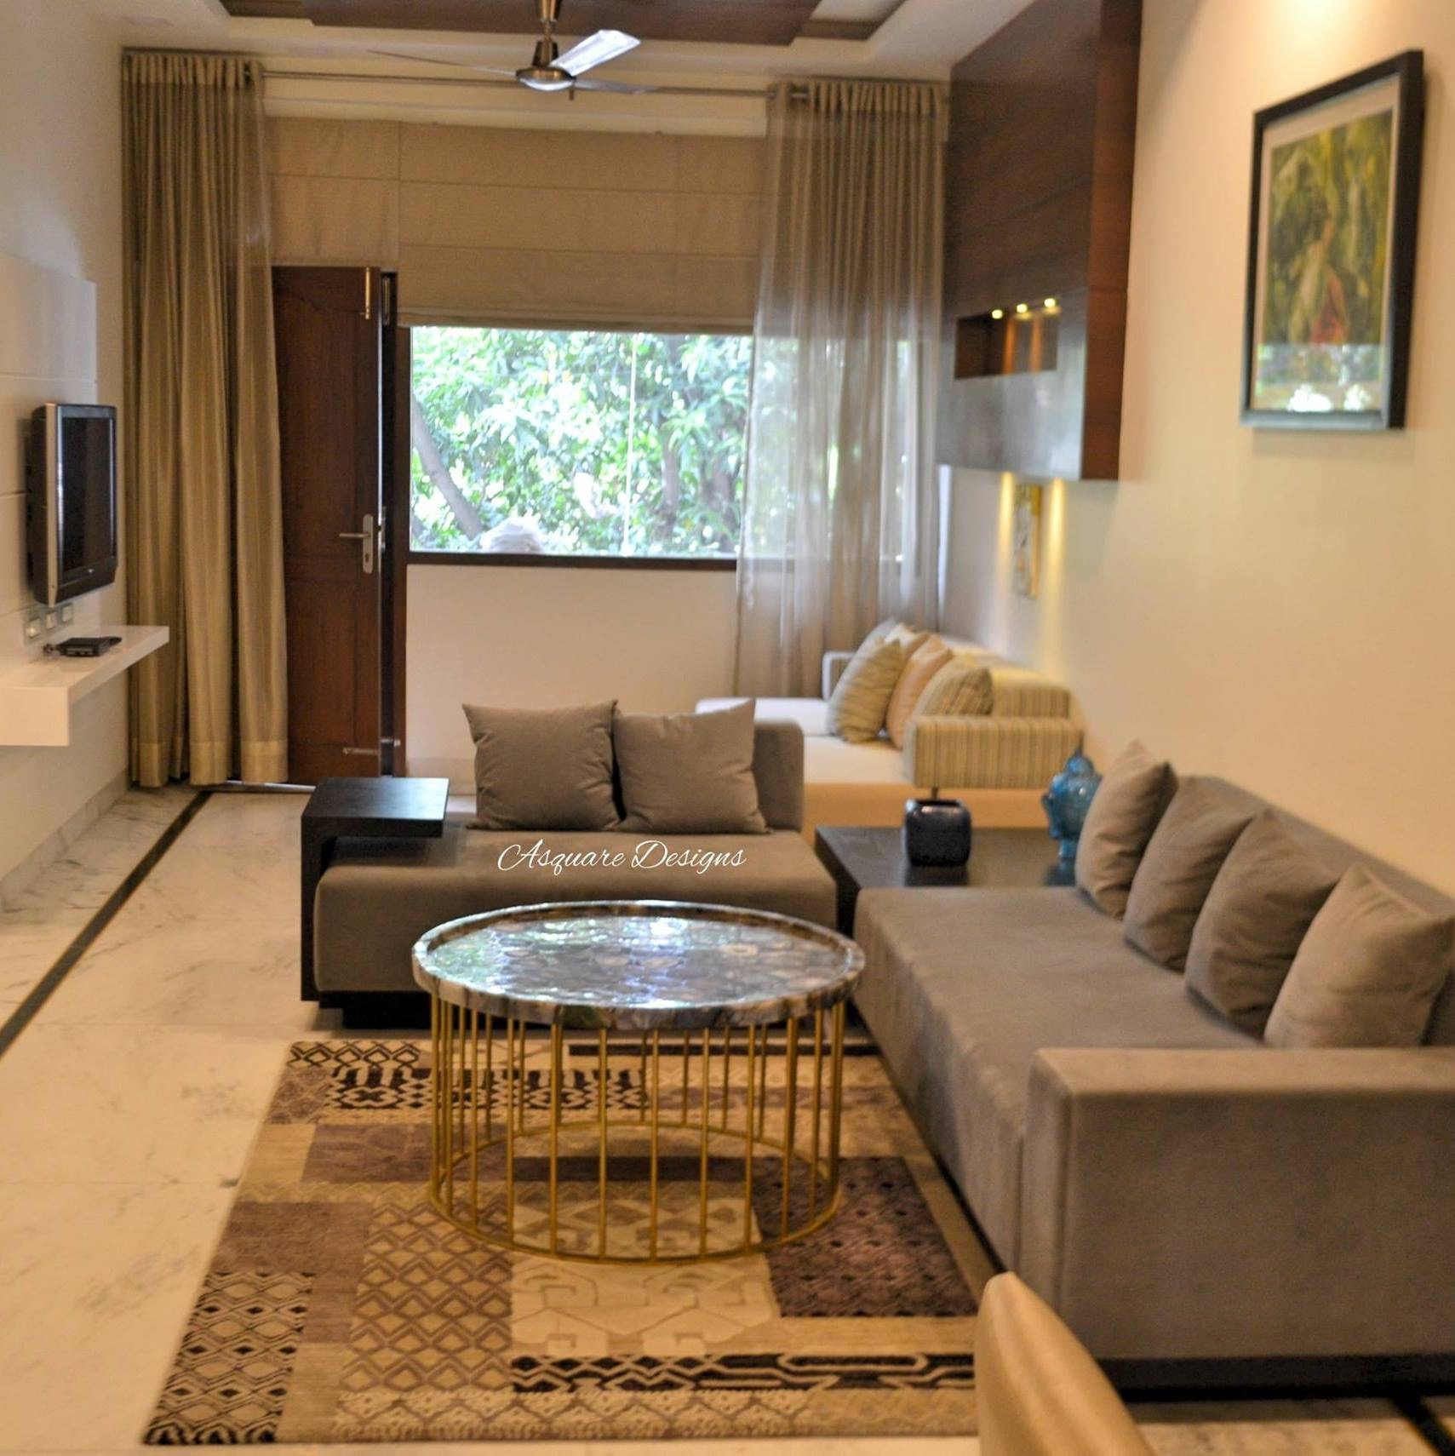
Our Finished Spaces

Slide 14
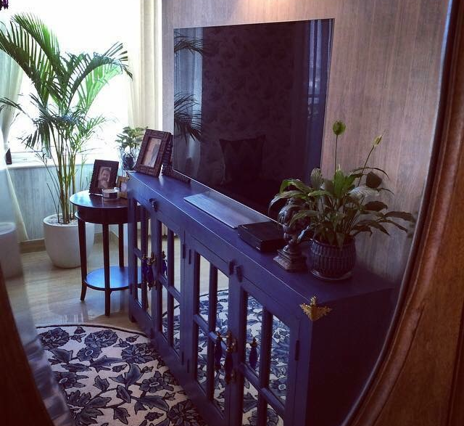
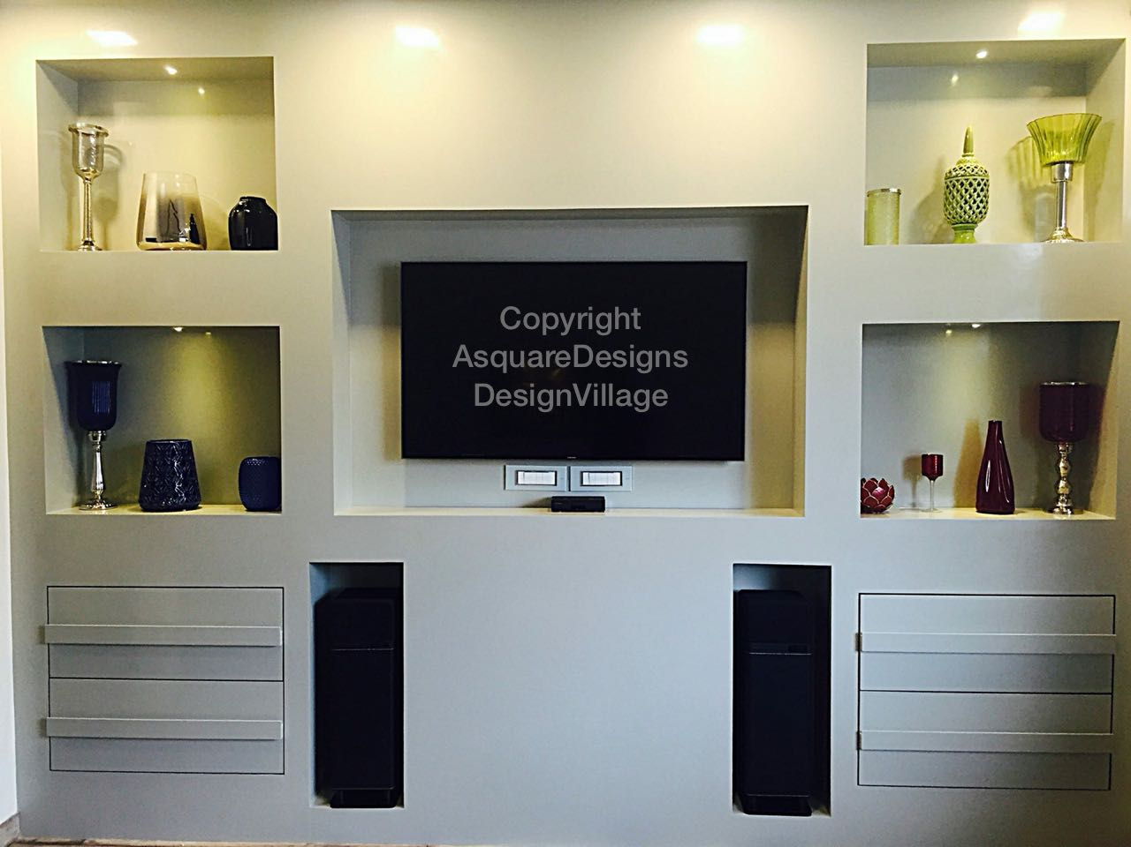
Our Finished Spaces

Slide 15
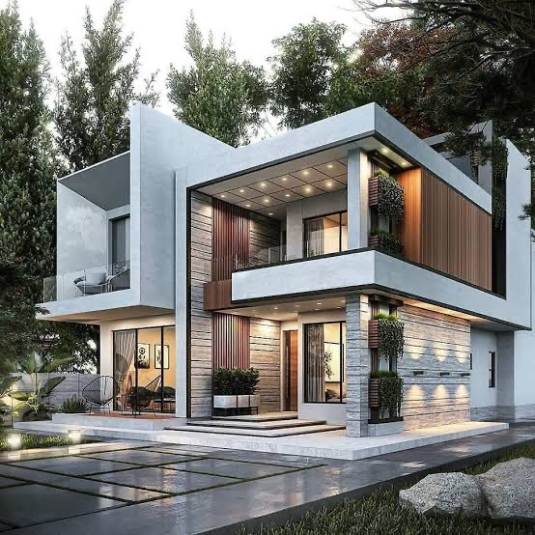
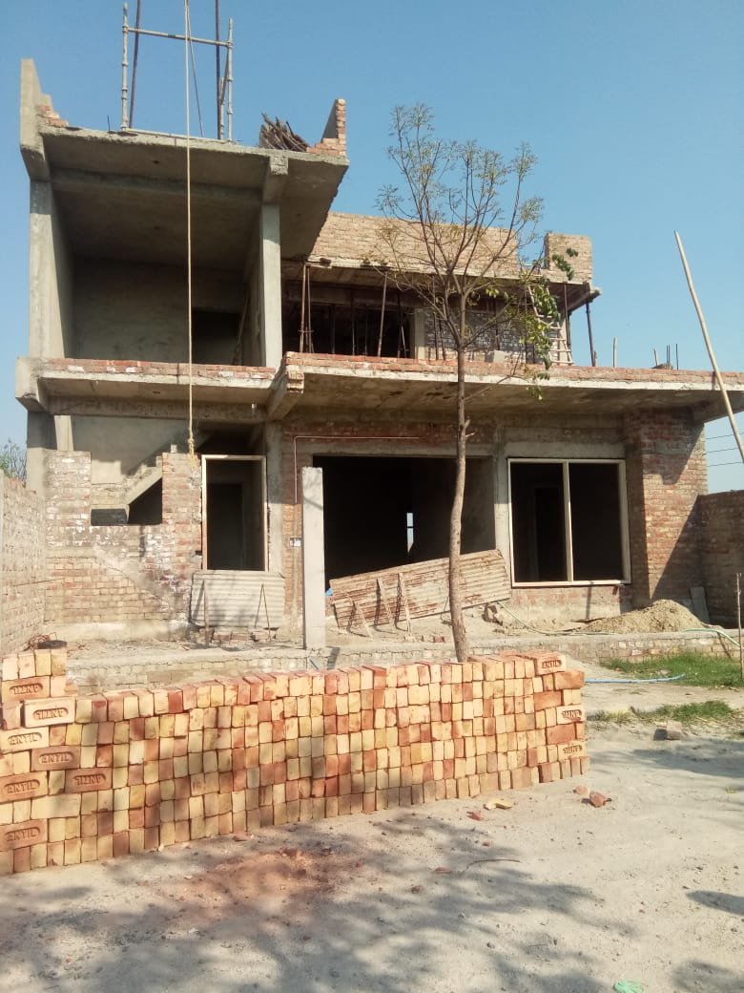
WELCOME ON BOARD WE SHALL BE HAPPY TO MAKE YOUR DREAM HOME COME TO LIFE

Slide 16
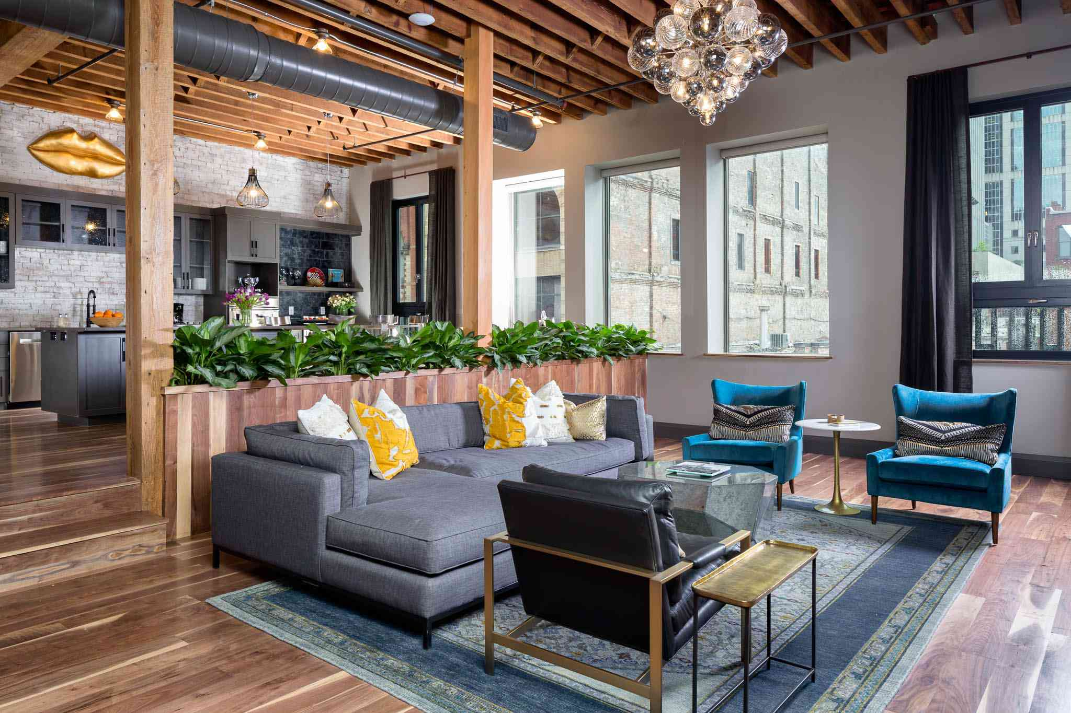
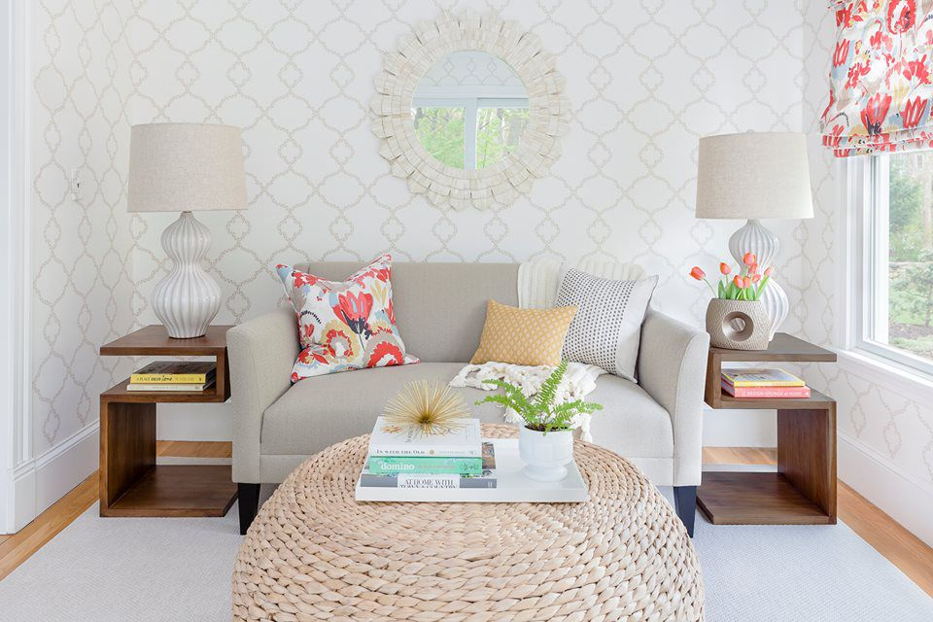
LIVING ROOM Living room is a room in a residential house or apartment for relaxing and socializing. Living room may contain furnishings such as a sofa, chairs, occasional tables, coffee tables, bookshelves, electric lamps, rugs, or other furniture.

Slide 17
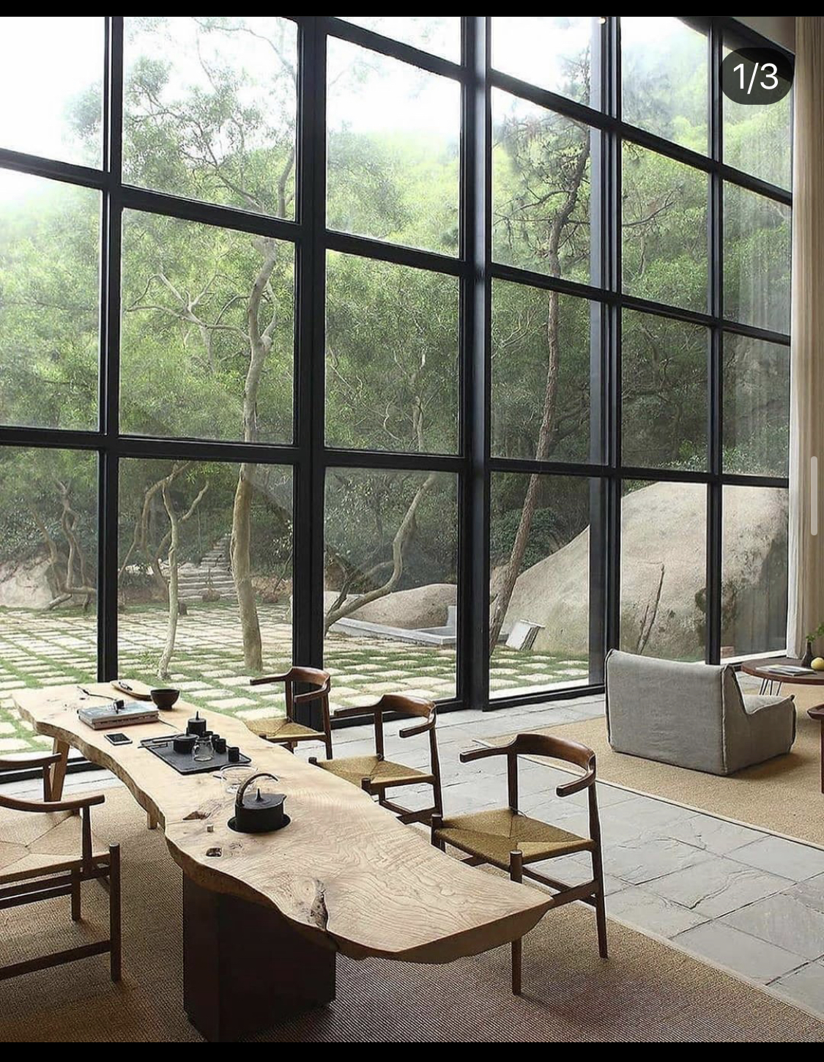
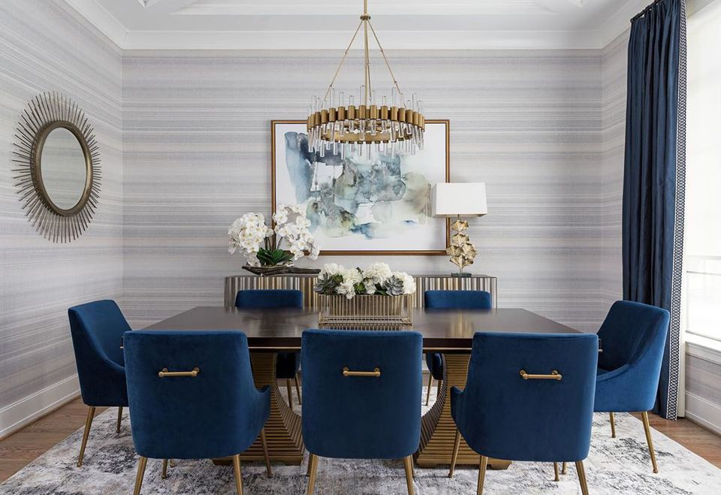
LOBBY
“A room providing a space out of which one or more other rooms or corridors lead, typically one near the entrance and family gathering seating commonly used for dining table

Slide 18
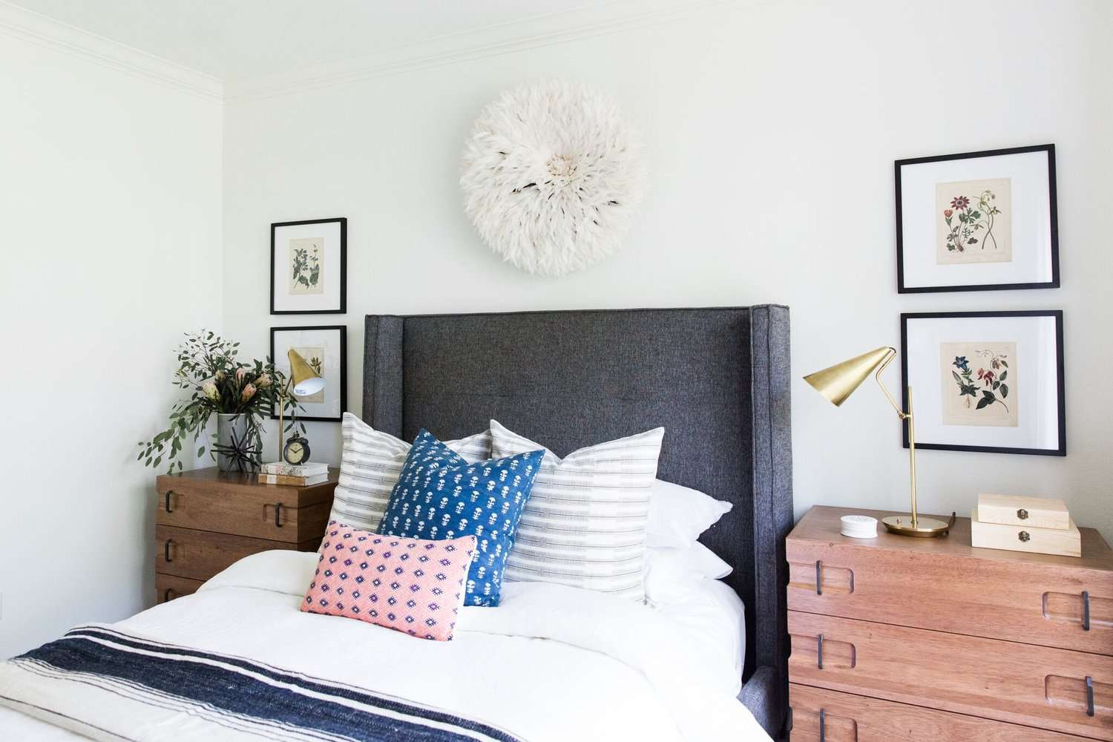
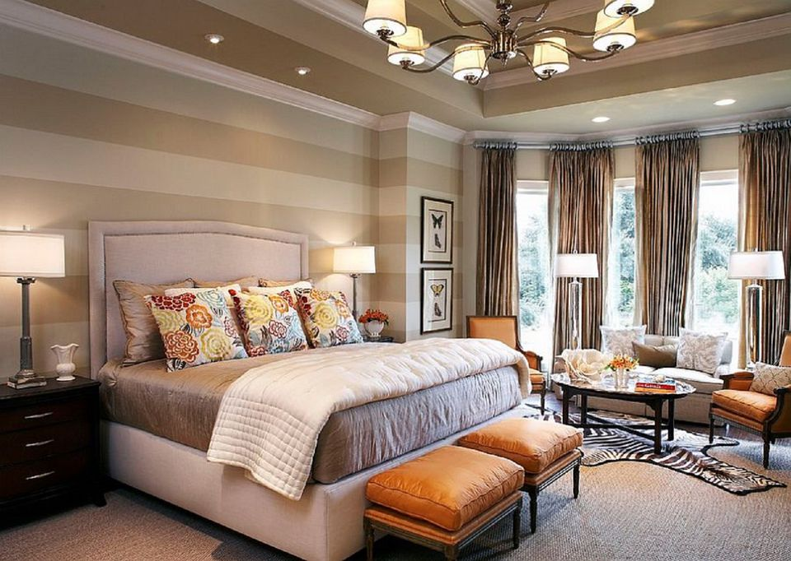
MASTER BEDROOM Why is it called the master bedroom? It's because a householder, if male, was known as the Master, the abbreviation for which is Mr. His wife the mistress of the house has the abbreviation Mrs. The master bedroom is the one used by the Master or the Master and his wife. ... The “master bedroom” was used in architectural plans to mean the owner's bedroom.

Slide 19
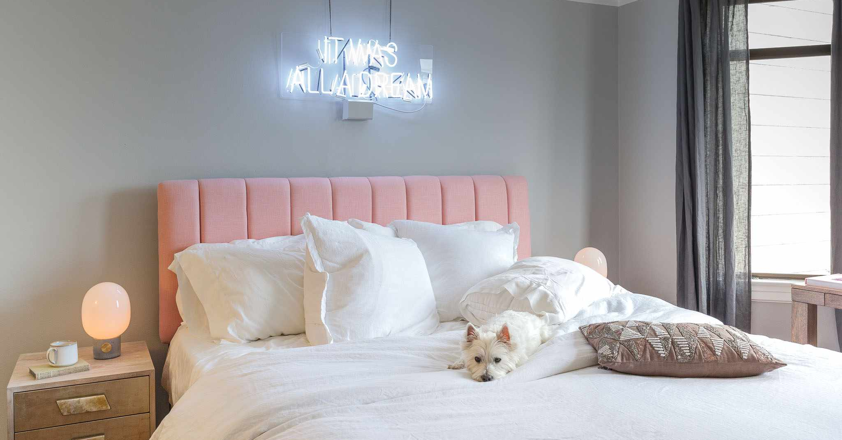
KIDS BEDROOM / RECREATIONAL ROOM

Slide 20
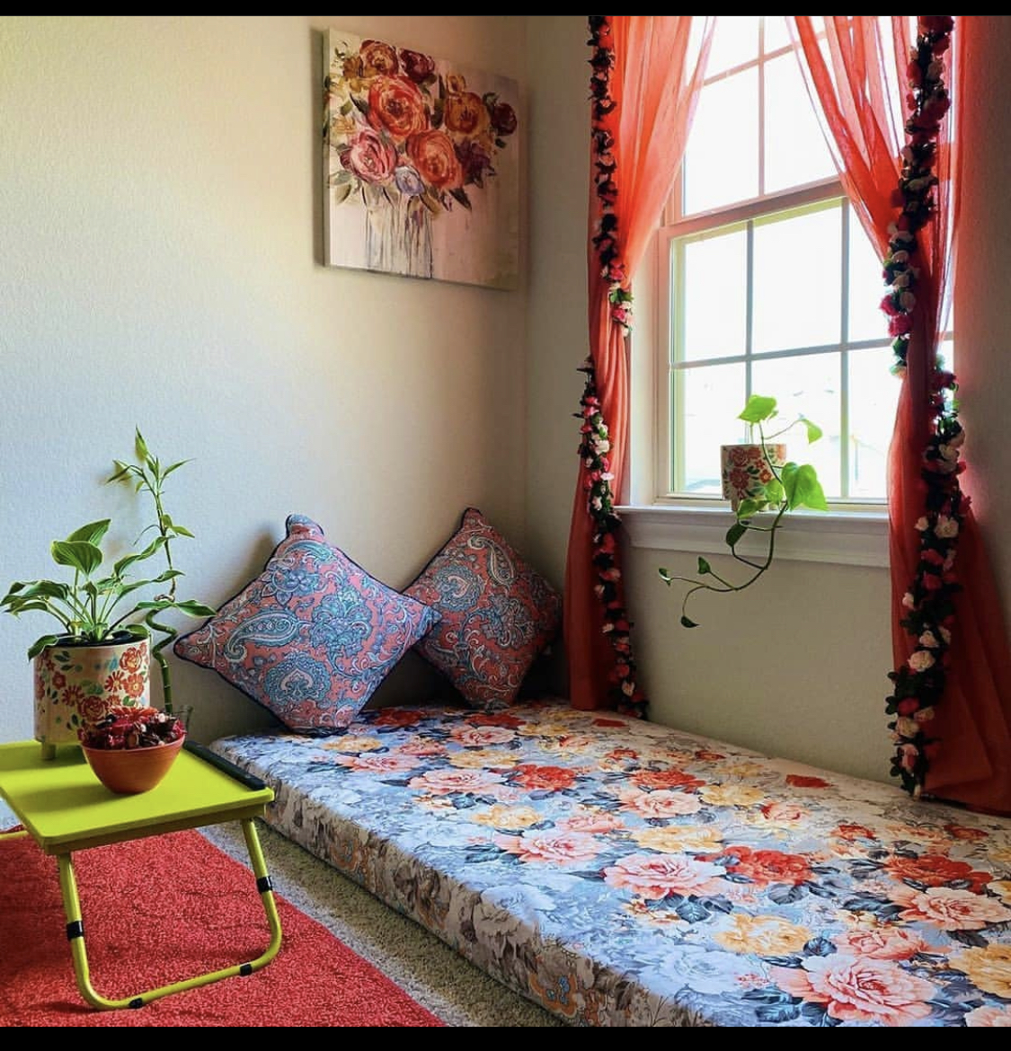
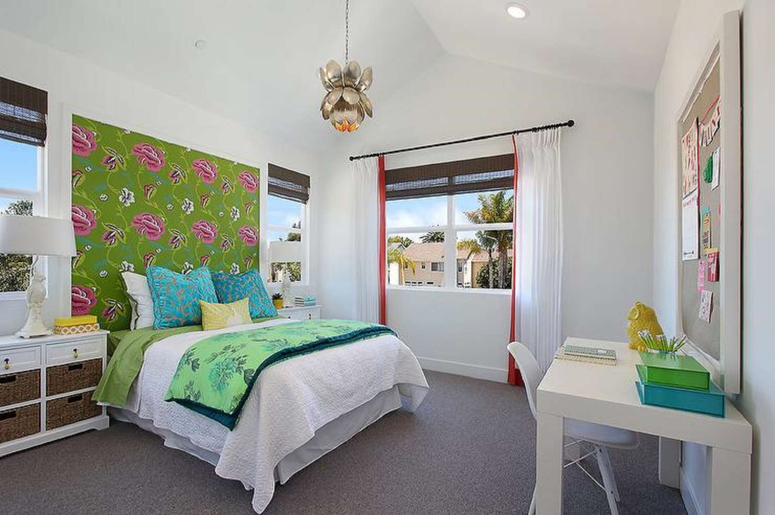

Slide 21
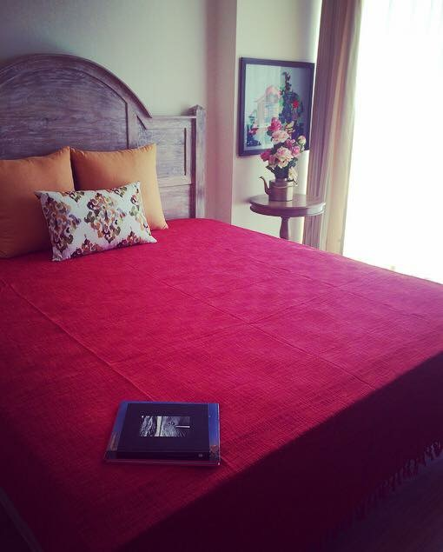
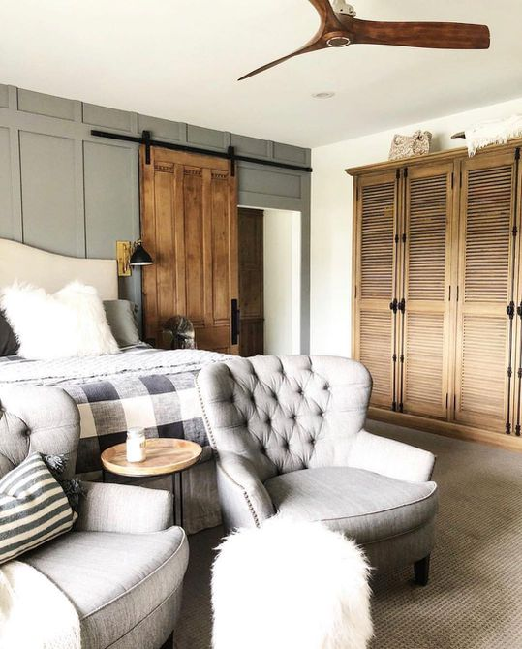
PARENTS BEDROOM

Slide 22
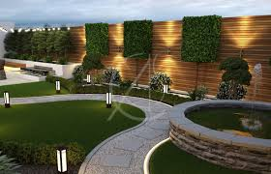
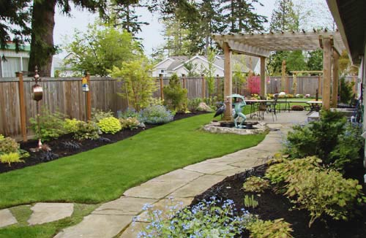
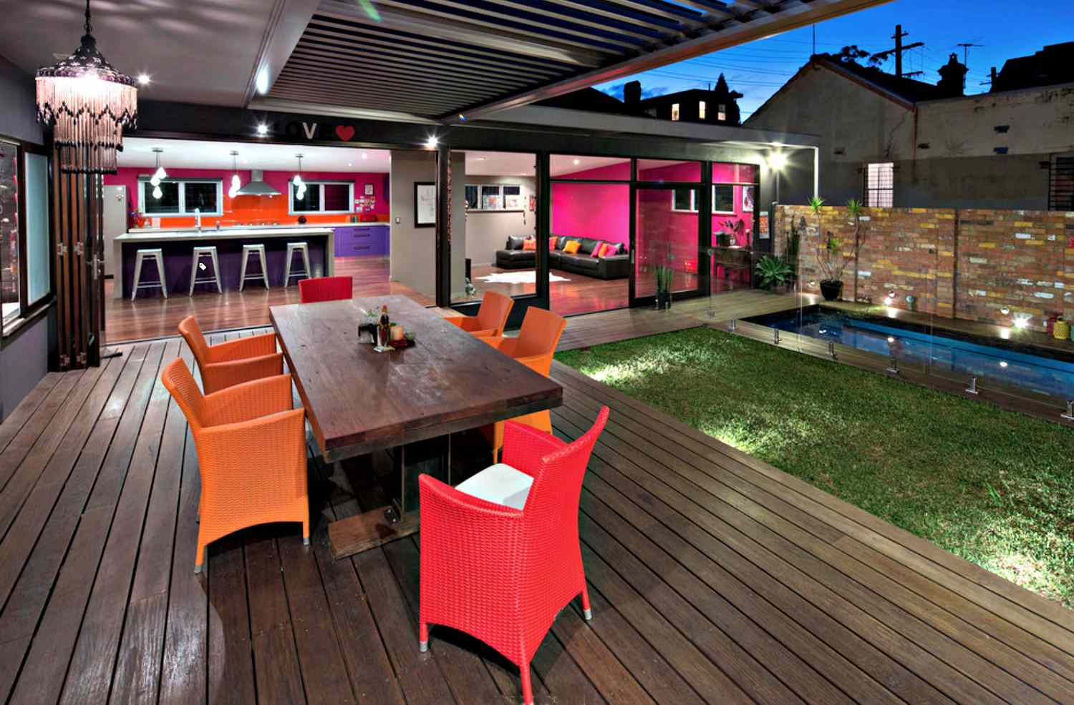
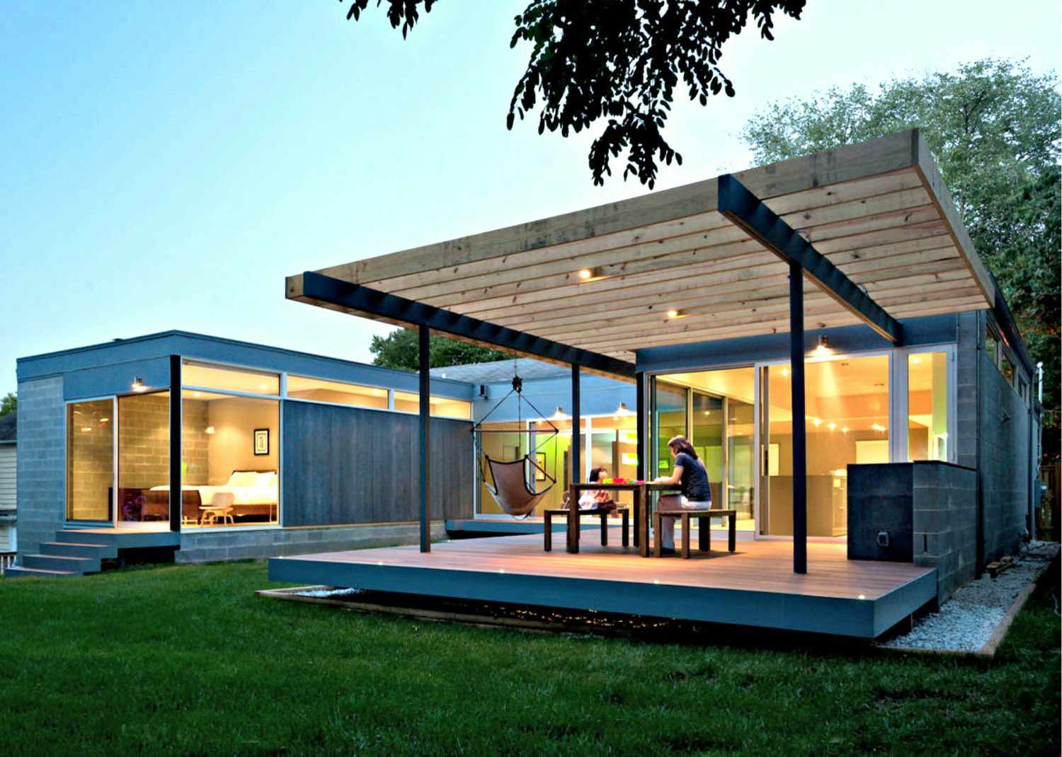
Outdoors

Slide 23
Bringing your dream to reality is what we will work for you in the below given methods you can choose from..
DDD – (DETAIL DESIGN DRAWINGS)
DESIGNING & SUPERVISION
TURN-KEY PROJECT
CONSTRUCTION
INTERIOR FURNITURE
HOME STYLING
ROOM BY ROOM

Slide 24

Experience is a good school , but fees have to be paid. OUR CHARGES BELOW FOR OUR SERVICES
DDD
We shall charge an amount of Rs.150 Rs. Sqft for the plot area
Under which we shall a provide you all detail drawings for Civil work –material details electrical – plumbing point – false ceiling – mood boards – basic furniture drawings 3d such as wardrobe & kitchens – 3d elevations of façade and one room with one time payment , and 1 site visit monthly to discuss with working team – client discussion . For 6months time period

Slide 25
Experience is a good school , but fees have to be paid. OUR CHARGES BELOW FOR OUR SERVICES
Designing & Supervision
We shall charge an amount of Rs.200 Sqft for the plot area under which we shall provide you all detail drawings for Civil work –material details electrical – plumbing point – false ceiling – mood boards – basic furniture drawings such as wardrobe & kitchens 3d elevations of façade and one room, with supervision on site by our
Designer or supervisor on weekly basis to keep check at site. For 6months period
If you want more regular supervision the per sqft charges will be increased by 235/-rs a sqft

Slide 26
Experience is a good school , but fees have to be paid. OUR CHARGES BELOW FOR OUR SERVICES
TURN-KEY PROJECT
We can help you construct your space beautifully with our workmanship experience and man-power with best possible fittings
Starting at Rs.2000/- Rs sqft under which we shall Serve you with design labour material
With no designing fees. FOR Civil and interiors
Furniture on turn-key basis
The entire house furniture shall be made by in our factories with fine quality and decided finishes “ask for details”

Slide 27
Experience is a good school , but fees have to be paid. OUR CHARGES BELOW FOR OUR SERVICES
HOME STYLING SERVICES
SOMETIMES WHEN CONFUSED BETWWEEN THE CHOICES AN EXPERT CHOICE CAN BE REALLY HELPFUL , WE GUIDE YOU THE RIGHT MATERIAL AS PER YOUR FAMILY NEEDS AND INVESTMENT, WE ALSO MAKE SURE TO MAKE SURE THAT EVEN A LIL YOU SPEND ON CORRECT MATERIAL AND OUR GUIDANCE WILL HELP YOU SAVE A MINIMUM OF 25% OF THE PROJECT COST , BY HELPING YOU GET CORRECT GUIDANCE ON MATERIAL CHOICES
FOR WHICH WE CHARGE Rs25,000/ + Travel

Slide 28
VASTU “A art for positivity in your home”
UNDERSTAND THE MEANING OF VASTU
https://www.youtube.com/watch?v=Winbsi_T8CA&t=1s
VASTU CONSULTANCY AVAILABLE TO KEEP YOUR HOME HAPPY POSITIVE AND FULL OF LOVE & JOYS
“ASK FOR DETAILS - 8368977624

Slide 29
ThankYou We Look Forward To Work with you , Not just to make your home look better but to make your life better

